Slide 2

Background
A common form of swarm control leverages virtual forces generated through proximity to neighbors [cite]
Often combined with orientation matching. Such agents are referred to as Boids (shown below)
Easy to implement with global sensing (i.e. Vicon) but this removes the swarm’s portability

Slide 3
Project Goal
Implement virtual force control using onboard sensing and computing
Explore emergent behavior resulting from inherent sensor limitations
Constraints:
No agent-to-agent communication that would reduce scalability
No specialized sensors
Portable anywhere the agents can operate

Slide 4
Simulations
Used MATLAB to create simulation environments
Allowed me to quickly iterate through possible onboard sensing configurations as I became familiar with blimp design and control
Early simulations used single integrator dynamics
Agents ‘sensed’ closest neighbors and simply moved to their average location

Slide 5
Simulations
A few obvious problems
Single integrator dynamics are not useful in most cases
Agents cannot always sense their closest neighbors, only the closest neighbors within the sensor’s ‘line of sight’
Did not account for seaweed

Slide 6
Simulations - Dynamics
Eventually moved to double integrator dynamics with orientation included as a state
Dampening values approximated with early blimp designs

Slide 7
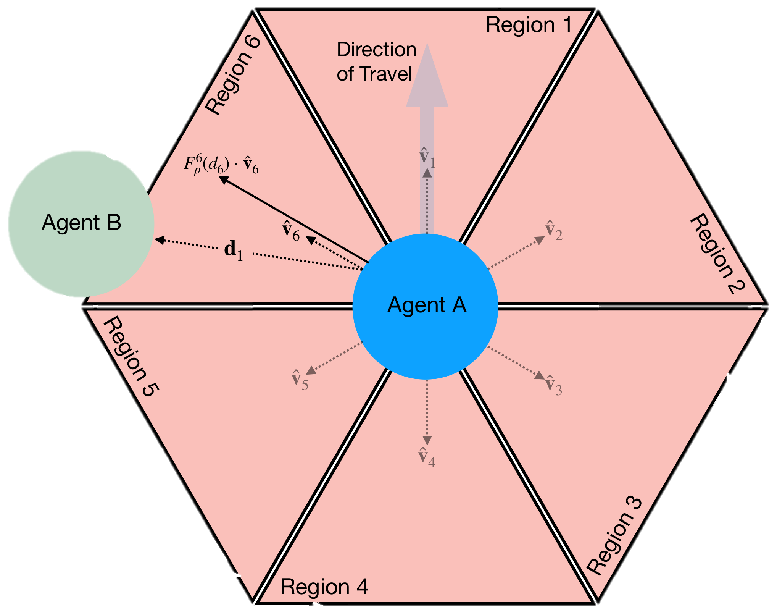
Simulations - Sensing
Senses the closest neighbors
Up to one neighbor sensed per region
If a zone had no neighbors within its sensing range, treat as empty
All agents share an orientation. Allows coordinated movement

Slide 8
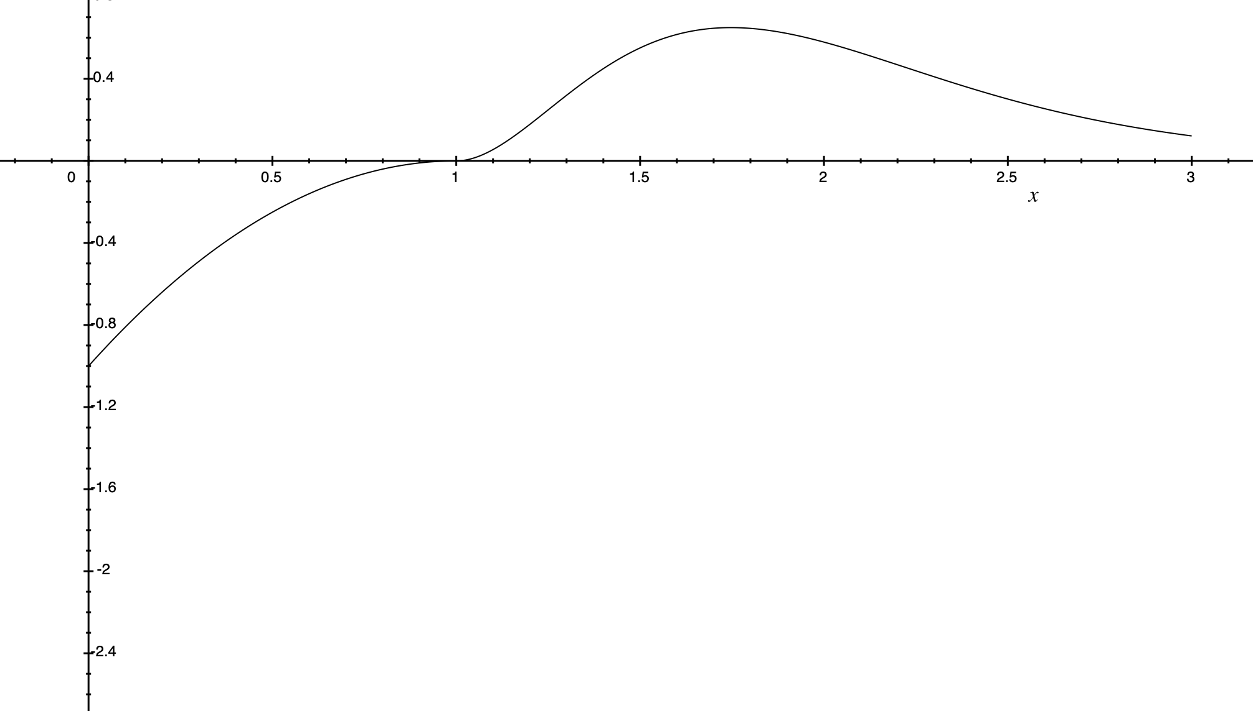
Simulations – Parameter Adjustment
Parameters where adjusted to reveal hidden emergent behavior
Only parameters that could be adjusted globally where explored including;
Virtual force characteristics
Force profile
Max force magnitudes
Equilibrium distance
Max sensing distance
Region based weighting
Global forces
Max number of neighbors sensed

Slide 9
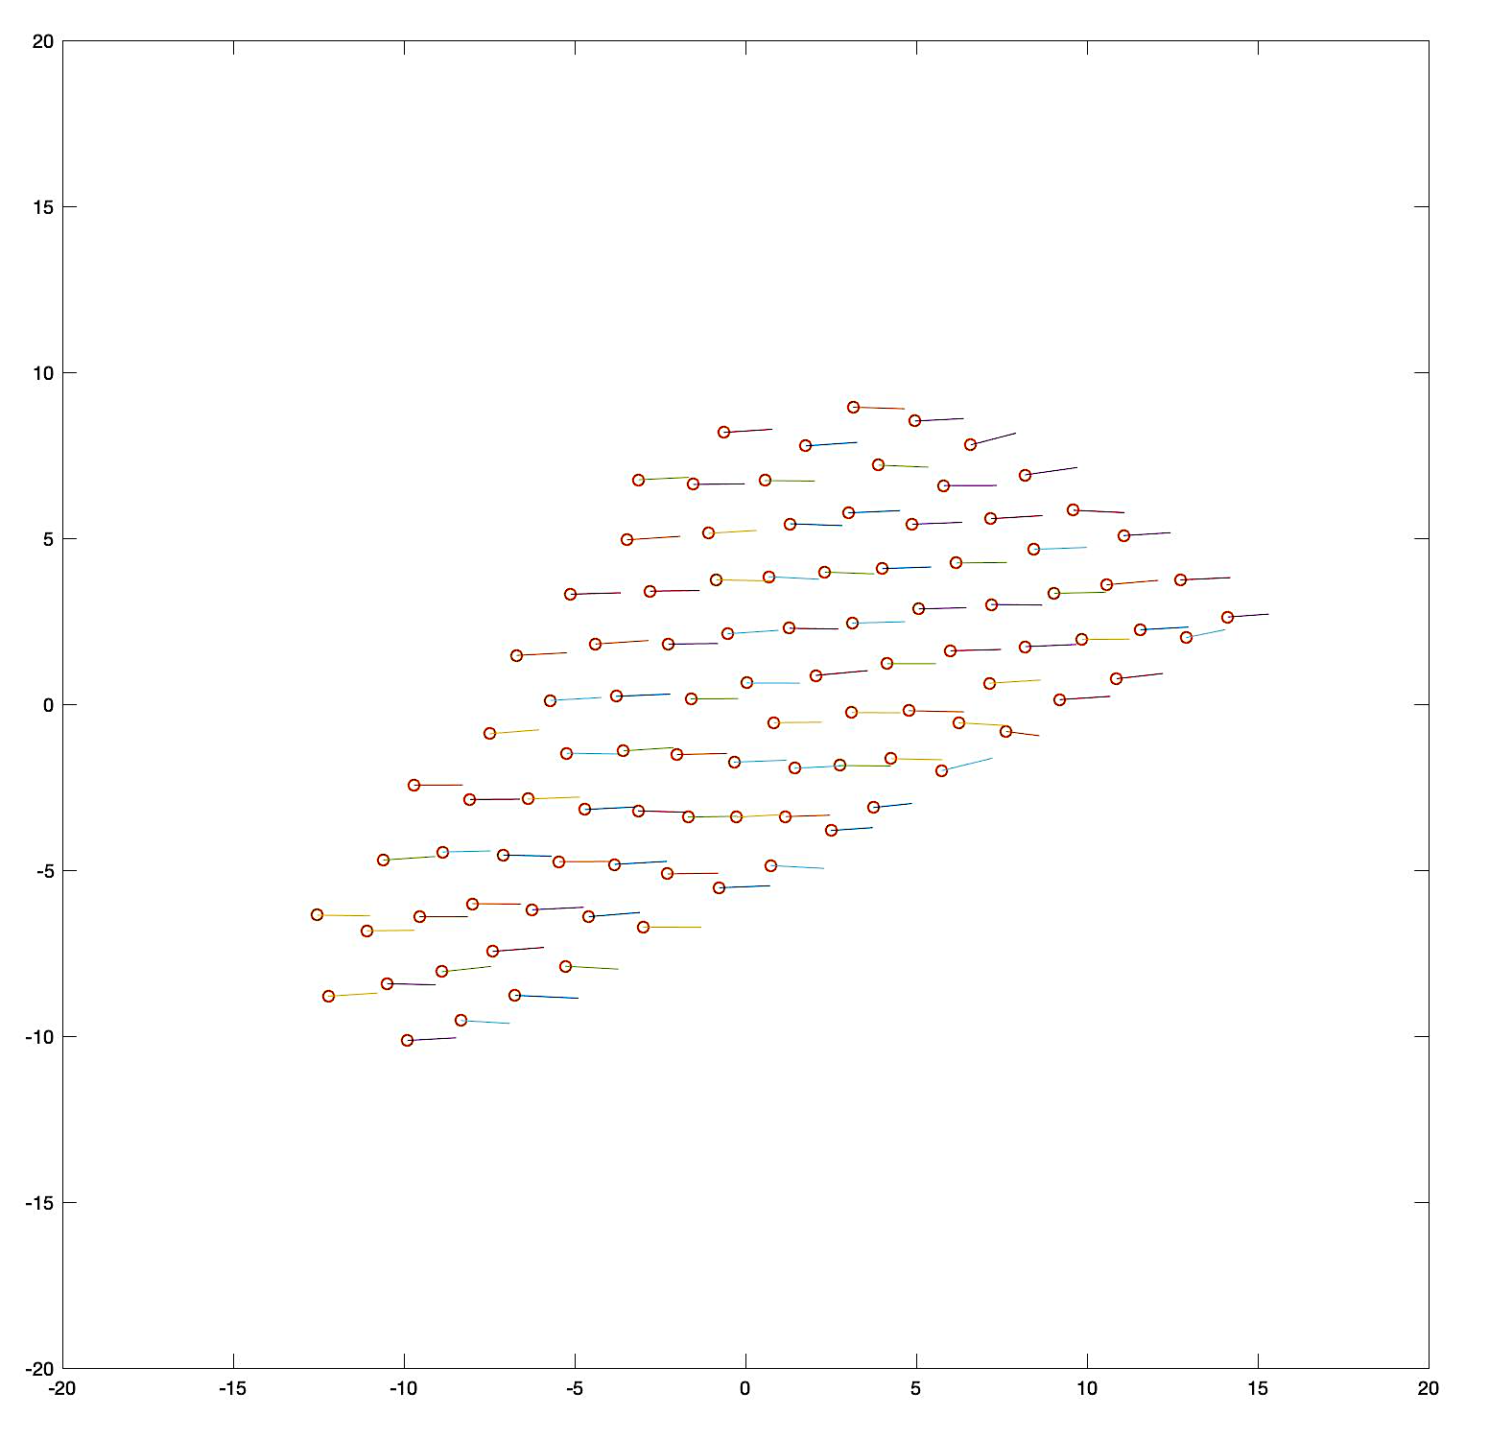
Simulations – Emergent Behavior
Basic emergent behavior such as clustering observed
Tuning the virtual force curve parameters allowed ordered ‘crystalline’ formations
Regional equilibrium distances and a global force resulted in an ‘Arrow Formation’

Slide 10
Agent Design - Goal
Build a LTA agent that would reflect the simulations using onboard computing and sensing alone
Be able to control the swarm’s position and properties using a single centralized controller, regardless of scaling

Slide 11
Agent Design
Control - Adafruit Feather M0
Communication – Integrated WIFI, UDP Broadcast Client
Relative Location - MaxBotix ping sensors (6-7 per agent)
Orientation – Adafruit BNO055 IMU sensor

Slide 12
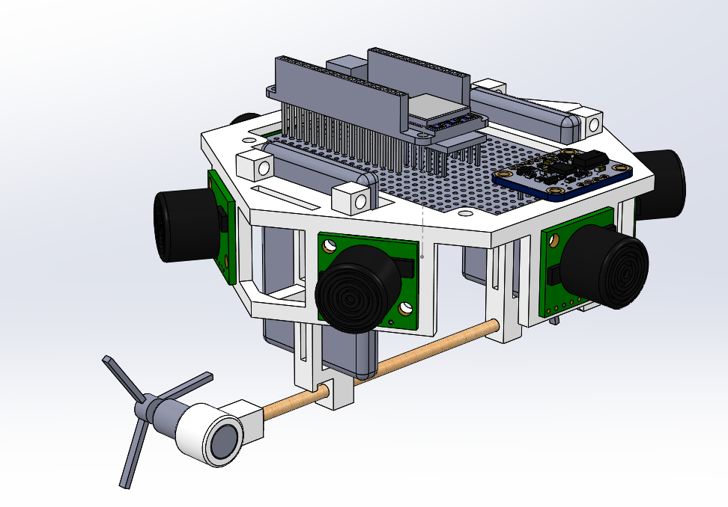
Agent Design – Ver 1
Two envelopes
Differential drive system
Drag sting altitude control

Slide 13
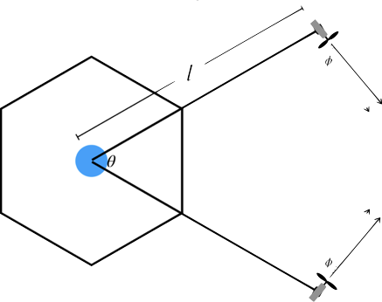
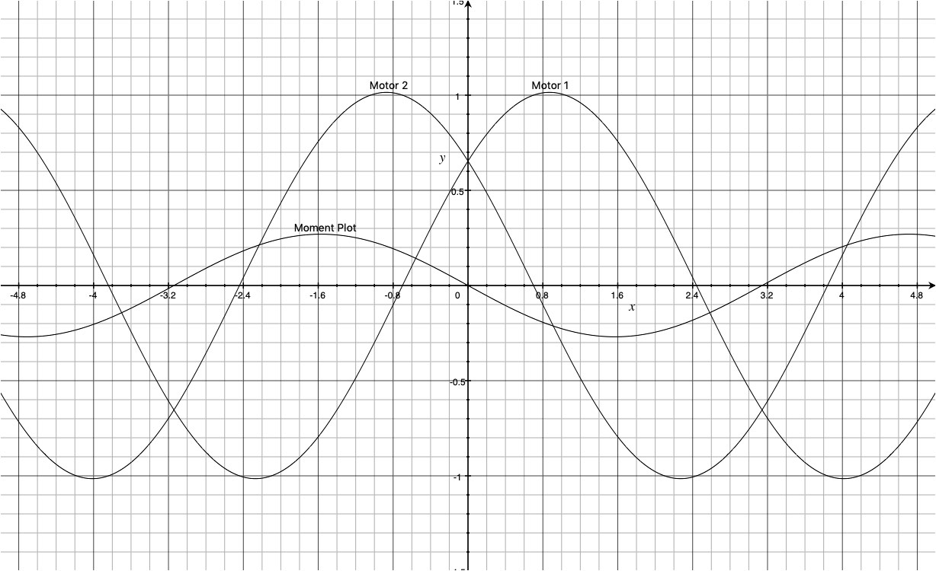
Agent Design – Ver 2
Offset Holonomic Drive
Unlike traditional holonomic drives, this drive maintains a forward direction
Simple to control. By just controlling for heading, a correcting moment is applied as a by product

Slide 14
Agent Design – Controller
Parse Global Input
Calculate Force Vectors
Sum Force Vectors and Input
Calculate Motor Inputs
Drive Motors
Servo Height
Setting up…
Configure Motor Driver
Connect to BlimpNet
Calibrate IMU
Begin Firing Pings
Read Ping Sensors
Clean Data
Fire Pings
Control Loop
Ping Interrupt Service Routine

Slide 15
Testing
Preliminary tests have been run to assess the qualitative nature of the blimps
Parameters that need tuning
Virtual force curve
Ping frequency
Ping data filtering
Ping positioning
Altitude PID parameters
Once tuned, Vicon will be used to capture the quantitative response to motor inputs
This data will be used to tune the simulation parameters until the results match

Slide 16
Future Work
Move the simulation from MATLAB to a faster platform such as Scrimmage
Develop a way for the agents to differentiate between a fellow agent and other objects. This would allow the agents to work in tight spaces without ‘sticking’ to the walls
Expand sensing to a sphere around the agent
Create a global State Space that includes things such as
Average swarm location
Swarm radius/density
Swarm fanning (column or row formations)
Implement deployable sensors that would allow a centralized controller to use the global State Space and an advanced control to accomplish a task

